Slide 1
Intrusion Detection Systems

Slide 2
IDS
IDS = Intrusion Detection System
We’re looking deeper into the packets than a firewall would
Looking at source/destination/protocol
Looking at the contents of the packets (data) too
Use signatures for known bad
Anomaly detection
Something looks different than normal?
Maybe it’s bad…

Slide 3
IDS vs. IPS
IDS = Intrusion Detection System
IPS = Intrusion Prevention System
IDS’s are purely passive, only looking at the traffic as it passes
Typically receive data from a span port
IPS’s can be active, and modify the traffic as it passes
Typically sit inline with the traffic
IDS will monitor, and throw an alert if something bad happens
IPS will monitor, throw an alert, and prevent bad from happening

Slide 4
Caution!
Be careful with active measures
If your IPS is not tuned properly, you could be blocking things you shouldn’t
Accidently blocking something that is legit, but looks suspicious…
Beware of bringing down applications
Beware of bringing down networks
Often, start an IPS in an IDS mode
Only detect and alert, don’t prevent/modify
Until you’re sure nothing critical is being blocked.

Slide 5
Signature Detection
Detect known threats
Uses prior knowledge of what an attack looks like
Alerts are high confidence
Easy to bypass
Hashes
Ports
IP Addresses
Other Artifacts
Signature Examples
Malicious File with a specific hash
Attacker can change one character in the file, results in a different hash
Port 4444 being connected to
Commonly used in meterpreter
Attacker can use a different port

Slide 6
Anomaly Detection
Detect threats based on non-standard activities
Uses prior knowledge of what normal looks like, and generates alerts based off abnormal
Alerts are not always high confidence
Slightly more difficult to bypass, but still possible
Behaviors
Ports
Protocol Analysis
Other Artifacts
Anomaly Examples
A login to an Admin account at 2am
Typically that user only logs in from 8-5, maybe that is a malicious use of the account?
SSL/TLS encrypted traffic on a port other than 443
We expect to see encrypted traffic on ports 443, 22, etc.
Seeing that traffic on, for example, port 80, would be anomalous. Malicious? Maybe.

Slide 7
Anomaly Detection – There’s More
Can go super deep with this topic, but we’re not going to
Signatures == easy bypass
Anomaly detection == often favored
Anomaly algorithms
Simple statistical techniques – mean, median, mode
Challenge: Normal and abnormal definitions can change
Machine Learning-based – AI, Neural Nets, Support Vector Machine, etc
Challenge: Much more complex, higher bar of entry

Slide 8
As we go forward…
…think…
How could we accurately and reliably detect XYZ?
Something malicious in the network
A malicious process
A malicious user/insider

Slide 9
Alert Fatigue – The Delicate Balance
Alert fatigue
When someone sees many false-positives, and become desensitized to alerts
There is a balance between…
Detecting everything
Why wouldn’t we NOT want to detect all the bad stuff?
Throwing zero false positives
Alert fatigue is bad
Greater chance of missing the true positives
One of the great challenges in this industry

Slide 10
IDS Rules

Slide 11
IDS Alerts
Many investigations start with an IDS alert
You won’t have pcap to START with
And you don’t want to look at pcap anyway
An alert will point you there
Wayyyyyy too much data in an enterprise to do otherwise
Even on a home network

Slide 12
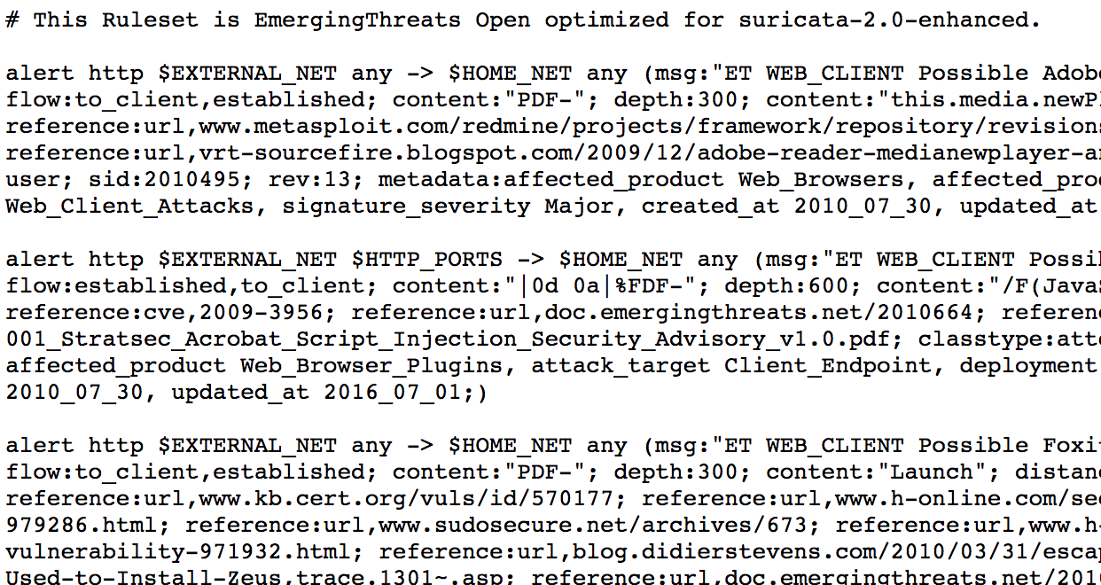
IDS Rules
Many rules come with Snort and Suricata
You can write your own rules, but you can’t write them for everything
All the vulnerabilities
All the exploits
All the policy violations
Free rulesets
Paid rulesets

Slide 13
Rulesets
ET = Emerging Threats
ET Open
Primarily Suricata
Free
ET Pro (Proofpoint)
Primarily Suricata
License fee per sensor
Snort Community
Snort Community
Primarily Snort
Free
Community-contributed
Snort Subscriber (Talos)
Snort only
License fee per sensor
Snort Registered
Snort only
Same as Snort Subscriber, but 30 days delayed

Slide 14
IDS Rules
There’s a bunch
Typically broken up into categories
DNS rules
Trojan rules
Worm rules
Games rules
http://rules.emergingthreats.net/open/suricata/rules/

Slide 15
What’s in a rule?
Syntax can vary from platform to platform
All will have similar components, though
IDS rules similar to firewall rules to start
Let’s look at Suricata specifically

Slide 16
Here’s a rule
alert tcp $HOME_NET 23 -> $EXTERNAL_NET any (msg:"GPL TELNET Bad Login"; flow:from_server,established; content:"Login incorrect"; nocase; fast_pattern:only; classtype:bad-unknown; sid:2101251; rev:9; metadata:created_at 2010_09_23, updated_at 2010_09_23;)
Detects bad telnet logins
Let’s break it down

Slide 17
Action
alert tcp $HOME_NET 23 -> $EXTERNAL_NET any (msg:"GPL TELNET Bad Login"; flow:from_server,established; content:"Login incorrect"; nocase; fast_pattern:only; classtype:bad-unknown; sid:2101251; rev:9; metadata:created_at 2010_09_23, updated_at 2010_09_23;)
If the rule matches, what should we do?
Alert
Log the traffic, and let it through
Pass
Just let it through
Drop
Stop the packet, do not inform the receiver or sender (IPS mode)
Reject
Stop the packet, inform the receiver and sender (IPS mode)

Slide 18
Protocol
alert tcp $HOME_NET 23 -> $EXTERNAL_NET any (msg:"GPL TELNET Bad Login"; flow:from_server,established; content:"Login incorrect"; nocase; fast_pattern:only; classtype:bad-unknown; sid:2101251; rev:9; metadata:created_at 2010_09_23, updated_at 2010_09_23;)
What protocol to match on?
TCP, UDP, ICMP
IP
Essentially ”any”
Suricata specific
HTTP, FTP, TLS, SMB, DNS

Slide 19
Source and Destination IPs
alert tcp $HOME_NET 23 -> $EXTERNAL_NET any (msg:"GPL TELNET Bad Login"; flow:from_server,established; content:"Login incorrect"; nocase; fast_pattern:only; classtype:bad-unknown; sid:2101251; rev:9; metadata:created_at 2010_09_23, updated_at 2010_09_23;)
IPv4, IPv6 addresses
Can also negate addresses
$HOME_NET and $EXTERNAL_NET
Defined in the IDS’s configuration
$HOME_NET defaults to private addresses
$EXTERNAL_NET is basically !$HOME_NET

Slide 20
Source and Destination Ports
alert tcp $HOME_NET 23 -> $EXTERNAL_NET any (msg:"GPL TELNET Bad Login"; flow:from_server,established; content:"Login incorrect"; nocase; fast_pattern:only; classtype:bad-unknown; sid:2101251; rev:9; metadata:created_at 2010_09_23, updated_at 2010_09_23;)
Can do ranges, negations
80, 82 Ports 80 and 82
80:82 Ports 80 through 82, inclusive
1024: Ports 1024 and higher (until 65535)
!80 Any port but port 80
Any All the ports

Slide 21
Direction
alert tcp $HOME_NET 23 -> $EXTERNAL_NET any (msg:"GPL TELNET Bad Login"; flow:from_server,established; content:"Login incorrect"; nocase; fast_pattern:only; classtype:bad-unknown; sid:2101251; rev:9; metadata:created_at 2010_09_23, updated_at 2010_09_23;)
Which way the signature has to match
Packets must flow in that direction
Most are an arrow to the right
->
Can also do bi-directional
<>

Slide 22
Try It
Example…
alert proto $HOME_NET any -> $EXTERNAL_NET any
Example_1.pcap
Packet 26
alert http $HOME_NET any -> $EXTERNAL_NET 80
alert http $HOME_NET any -> $EXTERNAL_NET any
Example_2.pcap
Packet 2
alert icmp $EXTERNAL_NET any -> $HOME_NET any
Example_3.pcap
Packet 10
alert smb any any -> $HOME_NET 445

Slide 23
Try It - Answers
Example…
alert proto $HOME_NET any -> $EXTERNAL_NET any
Example_1.pcap
Packet 26
alert tcp $HOME_NET any -> $EXTERNAL_NET 80
Example_2.pcap
Packet 2
Example_3.pcap
Packet 10

Slide 24
Try It - Answers
Example…
alert proto $HOME_NET any -> $EXTERNAL_NET any
Example_1.pcap
Packet 26
alert tcp $HOME_NET any -> $EXTERNAL_NET 80
Example_2.pcap
Packet 2
alert icmp $EXTERNAL_NET any -> HOME_NET any
Example_3.pcap
Packet 10

Slide 25
Try It - Answers
Example…
alert proto $HOME_NET any -> $EXTERNAL_NET any
Example_1.pcap
Packet 26
alert tcp $HOME_NET any -> $EXTERNAL_NET 80
Example_2.pcap
Packet 2
alert icmp $EXTERNAL_NET any -> HOME_NET any
Example_3.pcap
Packet 10
alert tcp any any -> $HOME_NET 445

Slide 26
Message
alert tcp $HOME_NET 23 -> $EXTERNAL_NET any (msg:"GPL TELNET Bad Login"; flow:from_server,established; content:"Login incorrect"; nocase; fast_pattern:only; classtype:bad-unknown; sid:2101251; rev:9; metadata:created_at 2010_09_23, updated_at 2010_09_23;)
Descriptive Message
Type of malware
Trojan, Ransomware, DDoS, etc.
Action of the malware
Checking, Activity, Exfil…

Slide 27
Different Types of Rules
ET Rulesets include (but not limited to…)
Activex.rules
Attack_response.rules
Botcc.rules
Chat.rules
Dns.rules
Dos.rules
Drop.rules
Files.rules
ftp.rules
Icmp.rules
Misc.rules
Netbios.rules
scan.rules
Shellcode.rules
Smtp.rules
Snmp.rules
telnet.rules
Tor.rules
Trojan.rules
Policy.rules
User_agents.rules
Worm.rules
Some note of this will go in the rule message

Slide 28
Message Examples
ET TELNET External Telnet Login Prompt from Cisco Device
Rule Creator
ET == Emerging Threats
Ruleset/Category
TELNET
MALWARE
Description
External Telnet Login Prompt from Cisco Device
Malware Type: Ransomware, DDoS, Adware, etc…
Be consistent and descriptive
This is SUPER important for logging and analysis!

Slide 29
Good or Bad?
CRRC TROJAN Mirage User Agent
CRRC INFO IP Lookup
CRRC POLICY Zeus Variant Checkin

Slide 30
Good or Bad?
CRRC TROJAN Mirage User Agent
Good!
CRRC INFO IP Lookup
CRRC POLICY Zeus Variant Checkin

Slide 31
Good or Bad?
CRRC TROJAN Mirage User Agent
Good!
CRRC INFO IP Lookup
No – not descriptive at all
CRRC POLICY Zeus Variant Checkin

Slide 32
Good or Bad?
CRRC TROJAN Mirage User Agent
Good!
CRRC INFO IP Lookup
No – not descriptive at all
CRRC POLICY Zeus Variant Checkin
No – Zeus checking in isn’t a policy violation

Slide 33
Flow
alert tcp $HOME_NET 23 -> $EXTERNAL_NET any (msg:"GPL TELNET Bad Login"; flow:from_server,established; content:"Login incorrect"; nocase; fast_pattern:only; classtype:bad-unknown; sid:2101251; rev:9; metadata:created_at 2010_09_23, updated_at 2010_09_23;)
More than source and dest ip
Client is the originator of the connection
Server is the responder
to_server == from_client
from_server == to_client
Most TCP rules will also contain “established”
UDP rules will just state the direction

Slide 34
Try It
msg:”CRRC Category Description”;flow: flow_direction;
You are writing a signature for a WannaCry DNS Lookup
_____________________
You are writing a signature for an executable payload from the Neutrino Exploit Kit as it enters the network
_____________________

Slide 35
Try It - Answers
msg:”CRRC Category Description”;flow: flow_direction;
You are writing a signature for a WannaCry DNS Lookup
msg:”CRRC TROJAN WannaCry Ransomware Domain Request”;flow:from_client;
You are writing a signature for an executable payload from the Neutrino Exploit Kit as it enters the network

Slide 36
Try It - Answers
msg:”CRRC Category Description”;flow: flow_direction;
You are writing a signature for a WannaCry DNS Lookup
msg:”CRRC TROJAN WannaCry Ransomware Domain Request”;flow:from_client;
You are writing a signature for an executable payload from the Neutrino Exploit Kit as it enters the network
msg:”CRRC CURRENT_EVENTS Neutrino EK Payload EXE”;flow:from_server,established;

Slide 37
Rule Headers
alert tcp $HOME_NET 23 -> $EXTERNAL_NET any (msg:"GPL TELNET Bad Login"; flow:from_server,established; content:"Login incorrect"; nocase; fast_pattern:only; classtype:bad-unknown; sid:2101251; rev:9; metadata:created_at 2010_09_23, updated_at 2010_09_23;)
Do not affect how the rule matches packets
Message to describe the rule
Aid the analyst

Slide 38
Rule Headers
Classtype
Provide some classification to the rules
Priority levels assigned in the classification.config file (/etc/suricata/classification.config on our VM)
Some examples…
Not-suspicious
Unknown
Successful-dos
Successful-admin
Suspicious-login
Policy-violation
Optional field
SID – Signature Identifier
Some allocated ranges
1000000-1999999 are for your local custom use
Ranges above are reserved for ET Open, ET Pro, Original Snort GPL, Dynamically updated rules, etc.
Required field

Slide 39
Rule Headers
Rev
Revision
Increments as changes are made to the signature over time
Optional field
Metadata
Really any key/value pair that you want
Optional field
Some examples…
Date reated
Tags
Performance impact
Attack target

Slide 40
Contents
alert tcp $HOME_NET 23 -> $EXTERNAL_NET any (msg:"GPL TELNET Bad Login"; flow:from_server,established; content:"Login incorrect"; nocase; fast_pattern:only; classtype:bad-unknown; sid:2101251; rev:9; metadata:created_at 2010_09_23, updated_at 2010_09_23;)
Unique packet contents
Can have multiple content sections
Many options
Nocase
Distance
Dsize
Isdataat
…and more…
Excellent guide: https://redmine.openinfosecfoundation.org/projects/suricata/wiki/Payload_keywords

Slide 41
Contents
Contents can be string based
content:”test”;
Contents can be hex based
content:”|00 2a 26 4a|”;
Or both!
content:”This | 20 | is | 20 | fun”;

Slide 42
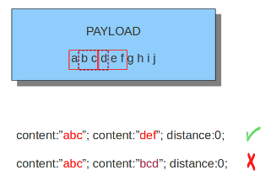
Content Options - Distance
Number of bytes between one content and the prior content match (relative)
How far to start looking after matching a previous content
Distance:0;
Used quite often
Means the content to be searched for MUST come after the previous content
Limits the search starting location, not the end
Can keep searching through the rest of the payload

Slide 43
Content Options - isdataat
Look to see if there is data at a specific location
Not checking for specific contents, just if there is something there
Can be relative or absolute
isdataat:256;
Looks at byte 256 for data
isdataat:40, relative;
Looks for data 40 bytes after the previous content match

Slide 44
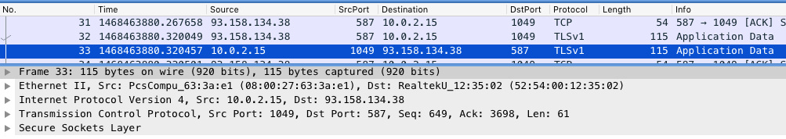
Content Options - dsize
Match on the size of the packet payload
This is the TCP segment length – not total packet length
Can be a number, greater/less, or range
dsize:55;
dsize:50 <> 75;
dsize:<123;

Slide 45
Try It (content, dsize, distance)
Example_4.pcap
Packet 10
dsize:_____;content:”_______”;
Example_3.pcap
Packet 185
dsize:___;content:”____”;content:”|________________|”;distance:0;
Example_5.pcap
Packet 14
dsize:______; content:”____ | ______|”; content:”____ |____|”; distance:____; content:”____ | ____|”; distance:____;

Slide 46
Try It (content, dsize, distance)
Example_4.pcap
Packet 10
dsize:12;content:”nocookie”;
Example_3.pcap
Packet 185
dsize:___;content:”____”;content:”|________________|”;distance:0;
Example_5.pcap
Packet 14
dsize:______; content:”____ | ______|”; content:”____ |____|”; distance:____; content:”____ | ____|”; distance:____;

Slide 47
Try It (content, dsize, distance)
Example_4.pcap
Packet 10
dsize:12;content:”nocookie”;
Example_3.pcap
Packet 185
dsize:102;content:”SMB”;content:”l| 00 |s| 00 |a| 00 |r| 00 |p| 00 |c”;distance:0;
dsize:102;content:”SMB”;content:”| 6c 00 73 00 61 00 72 00 70 00 63 |”;distance:0;
Example_5.pcap
Packet 14
dsize:______; content:”____ | ______|”; content:”____ |____|”; distance:____; content:”____ | ____|”; distance:____;

Slide 48
Try It - Answers
Example_4.pcap
Packet 10
dsize:12;content:”nocookie”;
Example_3.pcap
Packet 185
dsize:102;content:”SMB”;content:”l | 00 | s | 00 | a | 00 | r | 00 | p | 00 | c”;distance:0;
dsize:102;content:”SMB”;content:”| 6c 00 73 00 61 00 72 00 70 00 63 |”;distance:0;
Example_5.pcap
Packet 14
dsize:260; content:”MB | 00 00 |”; content:”Windows |20|”; distance:0; content:”V1.0 | 00 00 |”; distance:0;

Slide 49
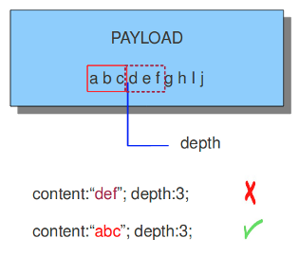
Content Options - Depth
How many bytes from the beginning of the payload will be checked
Example: depth of 3 means ONLY look within the first 3 bytes for a match

Slide 50
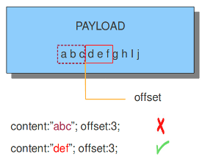
Content Options - Offset
Which byte in the payload will we start checking at
An offset of 3 starts checking for a content match at the 4th byte
Essentially, ignore the first X bytes before looking for a match
Depth and offset often used together

Slide 51
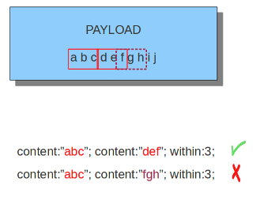
Content Options - Within
Number of bytes that one content must be found within after a previous content match (relative)
Limits the search ending location
Based on previous match

Slide 52
Try it (offset, depth, within, negation)
Example_6.pcap
Packet 41
Content:”| 00 01 00 00 00 01 |”; offset:__; depth:__; content:”| __ | eu | __ | “; distance:__; within:__;

Slide 53
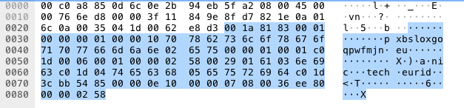
Try It - Answer
Example_6.pcap
Packet 41
Content:”| 00 01 00 00 00 01 |”; offset:__; depth:__; content:”| __ | eu | __ | “; distance:__; within:__;

Slide 54
Try It - Answer
Example_6.pcap
Packet 41
Content:”| 00 01 00 00 00 01 |”; offset:4; depth:6; content:”| 02 | eu | 00 | “; distance:19; within:4;

Slide 55
Put It All Together
VM with Suricata
Download pcaps to the VM
Create rules in custom.rules file
Test it by running runtest.sh and supplying a pcap
./runtest.sh example_1.pcap

Slide 56
Try It
Write a rule that detects if someone is attempting to log in to an FTP server as admin
Example_10.pcap
Hint: Packet 16011
Write a rule that detects a suspicious user agent found in example_11.pcap
Example_11.pcap
Write a rule that detects the nitol command and control traffic
Example_12.pcap
Packet 10

Slide 57
Try It - Answers
Write a rule that detects if someone is attempting to log in to an FTP server as admin
alert tcp any any -> any 21 (content:"USER| 20 |admin"; sid:10000000; rev:1; msg: ”CRRC FTP FTP Login attempt as admin"; sid:10000001; rev:1;))
Write a rule that detects a suspicious user agent found in example_11.pcap
alert tcp $HOME_NET any -> $EXTERNAL_NET 80 (flow:from_client,established; content:"HTTP|2f|1.1"; content:"User-Agent|3a 20|BlackSun"; distance:0; msg:"CRRC BLACKLIST Known malicious user-agent BlackSun"; classtype:trojan-activity; sid:10000002; rev:1;))
Write a rule that detects the nitol command and control traffic
alert tcp $HOME_NET any -> $EXTERNAL_NET any (msg:"CRRC TROJAN Nitol CnC"; flow:to_server,established; content:"|0b 00 00 00|"; depth:5; content:"Windows|20|"; distance:0; within:16; content:"|00|"; content:"|7c b4 ab b2 a5 7c|"; classtype:trojan-activity; sid:10000003; rev:1;)

